Slide 1

Report
Federal Government Satisfaction
Survey of Canadians
April 28, 2026

Slide 2
Introduction
Methodology
This week, we surveyed Canadians on politics, government performance, and key national issues.
Method
Online survey among respondents 18 years of age or older. (Canadian sample: n= 1,521)
Respondents had the option of completing the survey in French and English and were randomly recruited using LEO's online panel.
When
Data collection from April 24 to April 26, 2026.
Rounded data
The numbers presented have been rounded up. However, the numbers before rounding were used to calculate the sums presented and might therefore not correspond to the manual addition of these numbers.
Margin of error
For comparison purposes, a probability sample of this size yields a margin of error no greater than ±2.51%, (19 times out of 20) for the sample.
Weighting
Results were weighted according to age, gender, mother tongue, region, education and presence of children in the household in order to ensure a representative sample of the Canadian population.
Questions
Have questions about the data presented in this report? Please contact one of the following people:
Significant differences
Data in bold red characters indicate a significantly lower proportion than that of other respondents. Conversely, data in bold green characters indicate a significantly higher proportion than that of other respondents.
Sebastien Dallaire (sdallaire@leger360.com) Executive Vice-President, Eastern Canada
Andrew Enns (aenns@leger360.com) Executive Vice-President, Central Canada
Steve Mossop (smossop@leger360.com) Executive Vice-President, Western Canada
→
Notes
A more detailed methodology is presented in the Appendix.

Slide 3
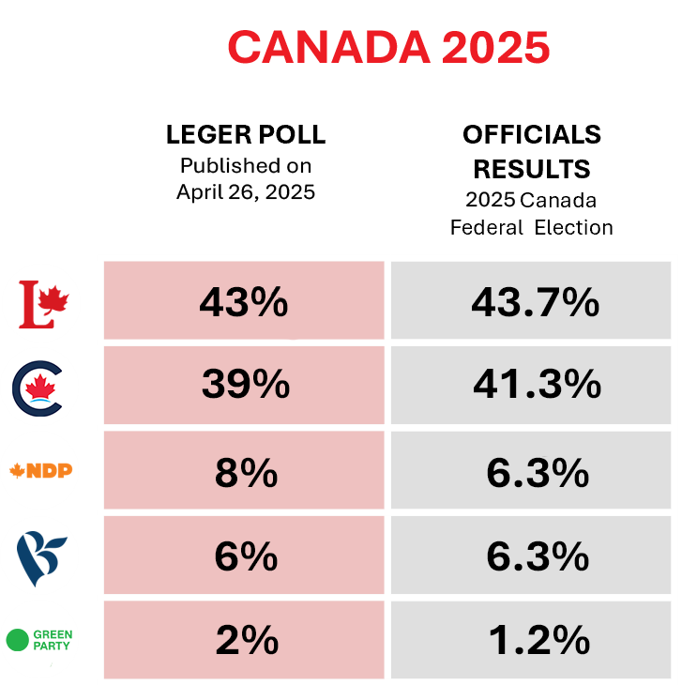
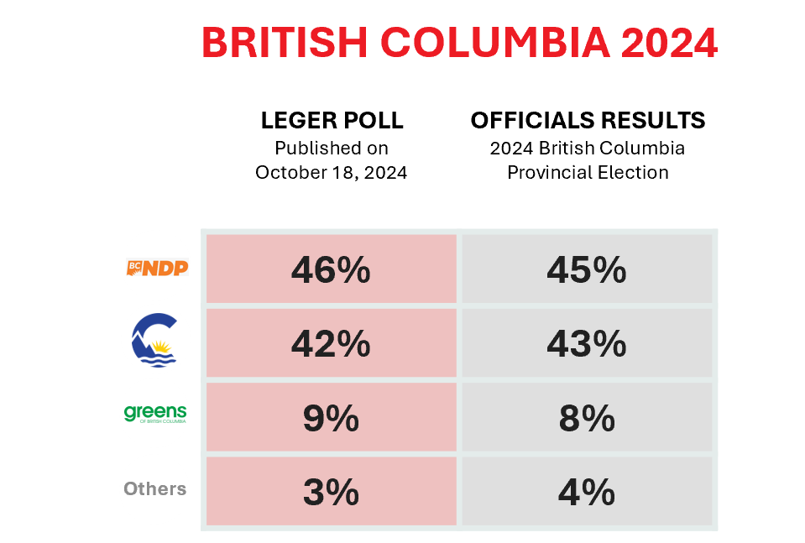
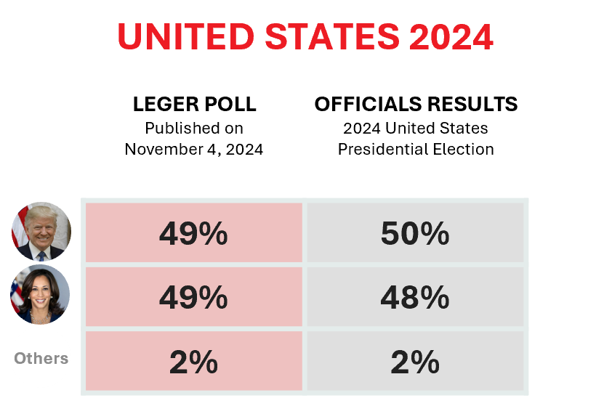
About polling
The Most Accurate Polling Firm in Canada

Slide 4
Key Highlights
FEDERAL VOTING INTENTIONS
The Liberals hold 48% among decided voters (-1 points since last month), maintaining a lead over the Conservatives at 37% (+2 points).
Among Liberal voters, 86% say they are likely to vote for the party again in the next election, particularly those in Alberta (97%) and British Columbia (93%). Very few (1%) say they are unlikely to do so.
GOVERNMENT PERFORMANCE
A majority of Canadians (57%) are satisfied with the federal government, while 35% are dissatisfied. Satisfaction is higher among Liberal voters (95%), Quebecers (67%) and those aged 55+ (67%), and lower in Alberta (40%) and among those aged 35–54 (49%).
Nearly six in ten Canadians (59%) approve of Mark Carney’s performance, compared to 33% who disapprove. Approval is higher among Quebecers (69%), those aged 55+ (69%), and among liberal voters (97%).
NOTWITHSTANDING CLAUSE
39% of Canadians say they are familiar with the notwithstanding clause, while 52% are not. Familiarity is higher among men (50%) and Albertans (50%), as well as with Liberal voters (48%).
Opinions are divided on its use, with 40% supporting and 39% opposing it. Support is higher among men (47%) and Liberal voters (51%).
More Canadians oppose preemptive use of the clause (46%) than support it (31%). Opposition is higher in Atlantic Canada (62%), Alberta (57%), those aged 55+ (51%), and among NDP voters (64%).
Some of the key highlights of our survey…

Slide 5
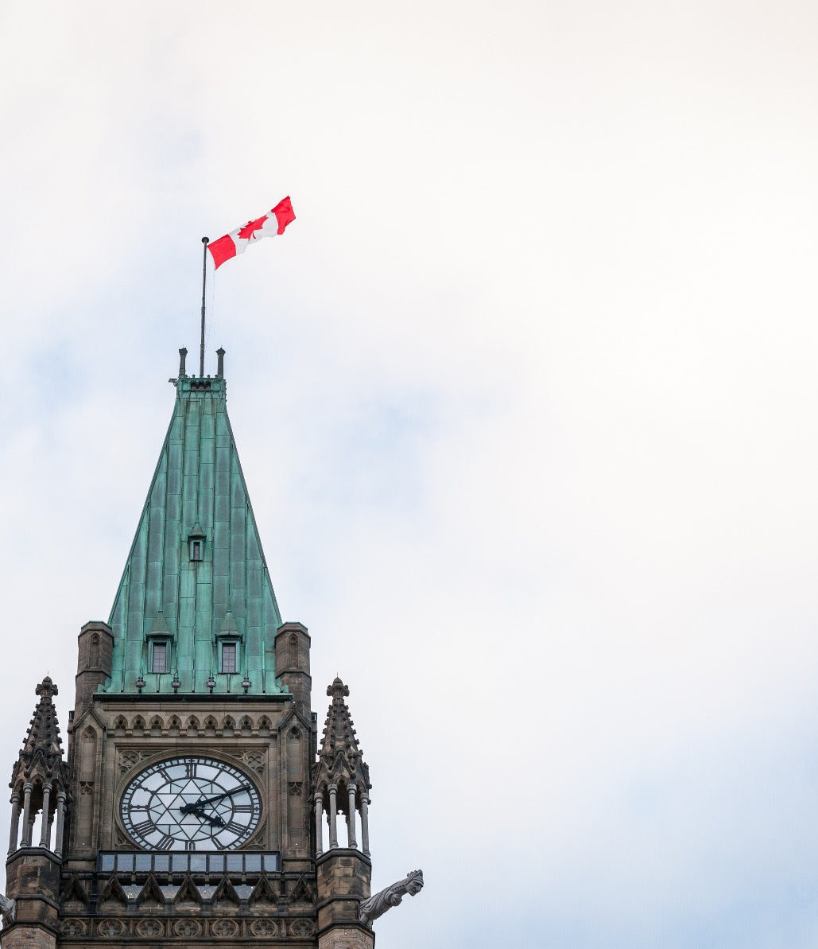
Federal Voting Intentions

Slide 6




Voting Intentions - Federal Elections (1/2)
Q1. If federal elections were held today, for which political party would you be most likely to vote? Would it be for...? In the event a respondent had no opinion, the following prompting question was asked: Even if you have not yet made up your mind, for which of the following political parties would you be most likely to vote? Would it be for the ...
Base: Decided voters (n=1,290) except for the Bloc Québécois, Quebecers only
Liberal Party of Canada
-1
Liberal Party of Canada
Conservative Party of Canada
+2
NDP
+1
Bloc Québécois
+1
Green Party of Canada
-1
…
Other Parties
-1
Note: The +/- are in comparison to the most recent measurement of voting intentions, on March 2nd, 2026.

Slide 7
Voting Intentions - Federal Elections (2/2)
Q1. If federal elections were held today, for which political party would you be most likely to vote? Would it be for...? In the event a respondent had no opinion, the following prompting question was asked: Even if you have not yet made up your mind, for which of the following political parties would you be most likely to vote? Would it be for the ...
Base: Decided voters (n=1,290) except for the Bloc Québécois, Quebecers only
 | Total Canada | Total Decided voters | ATL | QC | ON | MB/SK | AB | BC | Male | Female | 18-34 | 35-54 | 55+ | Urban | Sub- urban | Rural | Total March 2nd, 2026 | Gap
Weighted n= | 1,485 | 1,267 | 80 | 287 | 484 | 80 | 148 | 187 | 651 | 616 | 313 | 409 | 545 | 542 | 499 | 221 | 1,423
Unweighted n= | 1,480 | 1,290 | 84 | 341 | 511 | 106 | 109 | 139 | 730 | 560 | 303 | 386 | 601 | 555 | 501 | 228 | 1,435
… Mark Carney’s Liberal Party of Canada | 41% | 48% | 45% | 47% | 51% | 35% | 41% | 55% | 46% | 51% | 42% | 40% | 58% | 52% | 48% | 41% | 49% | -1
...Pierre Poilievre’s Conservative Party of Canada | 31% | 37% | 41% | 18% | 40% | 57% | 52% | 34% | 40% | 33% | 39% | 45% | 29% | 33% | 37% | 46% | 35% | +2
... Ari Lewis’ New Democratic Party of Canada | 5% | 6% | 10% | 4% | 7% | 6% | 3% | 10% | 6% | 7% | 12% | 7% | 3% | 7% | 7% | 5% | 5% | +1
... Yves-François Blanchet’s Bloc Québécois | 5% | 6% | - | 27% | - | - | - | - | - | - | - | - | - | - | - | - | 5% | +1
... Elizabeth May’s Green Party of Canada | 2% | 2% | 4% | 3% | 1% | 1% | 1% | 1% | 2% | 2% | 1% | 4% | 1% | 2% | 2% | 1% | 3% | -1
… another party | 1% | 1% | 0% | 0% | 0% | 1% | 3% | 0% | 1% | 0% | 1% | 0% | 0% | 0% | 1% | 1% | 2% | -1
I would not vote | 4% | - | - | - | - | - | - | - | - | - | - | - | - | - | - | - | - | -
I would cancel my vote | 1% | - | - | - | - | - | - | - | - | - | - | - | - | - | - | - | - | -
I don’t know | 8% | - | - | - | - | - | - | - | - | - | - | - | - | - | - | - | - | -
Refusal | 2% | - | - | - | - | - | - | - | - | - | - | - | - | - | - | - | - | -

Slide 8
Evolution of Voting Intentions in Canada
Others
*Official results from Elections Canada

Slide 9
Survey of Canadians
Likelihood to Vote Liberal in the Next General Election – Among Liberal Voters (1/2)
Q4. The Liberal government is now a majority government which means there will likely not be an election for several years—probably 2029. How likely are you to vote for Prime Minister Carney and the Liberals in the next general election?
Base: Liberal voters (n=692)
Total Likely: 86%
Total Not Likely: 1%

Slide 10
Survey of Canadians
Likelihood to Vote Liberal in the Next General Election – Among Liberal Voters (2/2)
Q4. The Liberal government is now a majority government which means there will likely not be an election for several years—probably 2029. How likely are you to vote for Prime Minister Carney and the Liberals in the next general election?
Base: Liberal voters (n=692)
 | Total CANADA | ATL | QC | ON | MB/SK | AB | BC | Male | Female | 18-34 | 35-54 | 55+
Weighted n= | 618 | 37 | 138 | 251 | 28 | 61 | 103 | 299 | 319 | 133 | 164 | 321
Unweighted n= | 692 | 50 | 171 | 301 | 43 | 49 | 78 | 376 | 316 | 136 | 181 | 375
TOTAL LIKELY | 86% | 94% | 82% | 82% | 79% | 97% | 93% | 88% | 84% | 86% | 85% | 86%
Very likely | 49% | 53% | 40% | 47% | 54% | 57% | 56% | 48% | 49% | 28% | 46% | 59%
Somewhat likely | 37% | 41% | 42% | 35% | 25% | 39% | 37% | 40% | 34% | 59% | 39% | 27%
TOTAL NOT LIKELY | 1% | 0% | 1% | 2% | 4% | 2% | 0% | 2% | 1% | 5% | 1% | 0%
Not very likely | 1% | 0% | 1% | 2% | 4% | 0% | 0% | 2% | 1% | 4% | 1% | 0%
Not at all likely | 0% | 0% | 0% | 0% | 0% | 2% | 0% | 0% | 0% | 1% | 0% | 0%
Don’t know | 13% | 6% | 17% | 16% | 17% | 2% | 7% | 10% | 15% | 9% | 14% | 13%

Slide 11
Government Performance

Slide 12
Survey of Canadians
Satisfaction of the Canadian Government Led by Mark Carney (1/2)
Q2. Are you very satisfied, somewhat satisfied, somewhat dissatisfied, or very dissatisfied with the Canadian government led by Mark Carney?
Base: All respondents (n=1,521)
Total Satisfied: 57%
Total Dissatisfied: 35%

Slide 13
Survey of Canadians
Satisfaction of the Canadian Government Led by Mark Carney (2/2)
Q2. Are you very satisfied, somewhat satisfied, somewhat dissatisfied, or very dissatisfied with the Canadian government led by Mark Carney?
Base: All respondents (n=1,521)
 | Total CANADA | ATL | QC | ON | MB/SK | AB | BC | Male | Female | 18-34 | 35-54 | 55+ | Total March 2nd, 2026 | Gap
Weighted n= | 1,521 | 100 | 352 | 590 | 98 | 170 | 211 | 743 | 778 | 403 | 491 | 627 | 1,627
Unweighted n= | 1,521 | 101 | 405 | 610 | 125 | 125 | 155 | 822 | 699 | 381 | 462 | 678 | 1,627
TOTAL SATISFIED | 57% | 44% | 67% | 57% | 40% | 53% | 61% | 59% | 56% | 52% | 49% | 67% | 59% | -2
Very satisfied | 20% | 15% | 17% | 19% | 20% | 21% | 28% | 20% | 20% | 10% | 13% | 32% | 19% | +1
Somewhat satisfied | 37% | 29% | 50% | 37% | 20% | 32% | 34% | 39% | 36% | 42% | 36% | 36% | 41% | -4
TOTAL DISSATISFIED | 35% | 48% | 24% | 37% | 49% | 41% | 32% | 35% | 35% | 36% | 43% | 28% | 33% | +2
Somewhat dissatisfied | 14% | 14% | 13% | 15% | 15% | 13% | 12% | 13% | 15% | 19% | 15% | 9% | 13% | +1
Very dissatisfied | 21% | 34% | 11% | 22% | 35% | 28% | 20% | 23% | 20% | 17% | 28% | 19% | 19% | +2
Don’t know | 8% | 8% | 10% | 7% | 11% | 6% | 7% | 6% | 10% | 12% | 8% | 5% | 8% | =

Slide 14
Survey of Canadians
Satisfaction of the Canadian Government Led by Mark Carney – By Voting Intentions
Q2. Are you very satisfied, somewhat satisfied, somewhat dissatisfied, or very dissatisfied with the Canadian government led by Mark Carney?
Base: All respondents (n=1,521)
 | Total Canada | LPC | CPC | NDP | BQ | GPC
Weighted n= | 1,521 | 611 | 466 | 81 | 78 | 23
Unweighted n= | 1,521 | 680 | 385 | 106 | 88 | 22*
TOTAL SATISFIED | 57% | 95% | 19% | 62% | 65% | 57%
Very satisfied | 20% | 44% | 3% | 4% | 4% | 16%
Somewhat satisfied | 37% | 51% | 17% | 57% | 61% | 41%
TOTAL DISSATISFIED | 35% | 3% | 78% | 35% | 29% | 39%
Somewhat dissatisfied | 14% | 3% | 22% | 25% | 18% | 20%
Very dissatisfied | 21% | 0% | 55% | 11% | 10% | 20%
Don’t know | 8% | 2% | 3% | 3% | 6% | 4%
*Due to the low number of respondents (n<30), results are presented for indicative purposes only.

Slide 15
Survey of Canadians
Satisfaction of the Canadian Government Led by Mark Carney – Trended
Q2. Are you very satisfied, somewhat satisfied, somewhat dissatisfied, or very dissatisfied with the Canadian government led by Mark Carney?
Base: All respondents

Slide 16
Survey of Canadians
Approval of Prime Minister Carney’s Performance to Date (1/2)
Q3. Thinking of Prime Minister Carney and how he has performed so far, in your opinion do you approve or disapprove of the job he is doing?
Base: All respondents (n=1,521)
Total Approve: 59%
Total Disapprove: 33%

Slide 17
Survey of Canadians
Approval of Prime Minister Carney’s Performance to Date (2/2)
Q3. Thinking of Prime Minister Carney and how he has performed so far, in your opinion do you approve or disapprove of the job he is doing?
Base: All respondents (n=1,521)
 | Total CANADA | ATL | QC | ON | MB/SK | AB | BC | Male | Female | 18-34 | 35-54 | 55+ | Total March 2nd, 2026 | Gap
Weighted n= | 1,521 | 100 | 352 | 590 | 98 | 170 | 211 | 743 | 778 | 403 | 491 | 627 | 1,627
Unweighted n= | 1,521 | 101 | 405 | 610 | 125 | 125 | 155 | 822 | 699 | 381 | 462 | 678 | 1,627
TOTAL APPROVE | 59% | 49% | 69% | 59% | 43% | 49% | 63% | 60% | 58% | 52% | 51% | 69% | 61% | -2
Strongly approve | 21% | 14% | 20% | 22% | 20% | 17% | 29% | 21% | 22% | 9% | 14% | 35% | 22% | -1
Somewhat approve | 38% | 34% | 49% | 37% | 23% | 32% | 34% | 39% | 37% | 43% | 38% | 34% | 39% | -1
TOTAL DISAPPROVE | 33% | 44% | 21% | 34% | 47% | 41% | 33% | 35% | 31% | 34% | 41% | 26% | 31% | +2
Somewhat disapprove | 12% | 10% | 12% | 13% | 8% | 15% | 13% | 13% | 12% | 18% | 13% | 8% | 13% | -1
Strongly disapprove | 21% | 34% | 9% | 21% | 39% | 27% | 20% | 22% | 19% | 16% | 28% | 18% | 18% | +3
Don’t know | 8% | 7% | 10% | 7% | 10% | 9% | 5% | 5% | 11% | 13% | 8% | 5% | 9% | -1

Slide 18
Survey of Canadians
Approval of Prime Minister Carney’s Performance to Date – By Voting Intentions
Q3. Thinking of Prime Minister Carney and how he has performed so far, in your opinion do you approve or disapprove of the job he is doing?
Base: All respondents (n=1,521)
 | Total Canada | LPC | CPC | NDP | BQ | GPC
Weighted n= | 1,521 | 611 | 466 | 81 | 78 | 23
Unweighted n= | 1,521 | 680 | 385 | 106 | 88 | 22*
TOTAL APPROVE | 59% | 97% | 20% | 64% | 69% | 63%
Strongly approve | 21% | 47% | 2% | 9% | 5% | 5%
Somewhat approve | 38% | 50% | 18% | 55% | 64% | 58%
TOTAL DISAPPROVE | 33% | 2% | 76% | 35% | 24% | 33%
Somewhat disapprove | 12% | 2% | 22% | 22% | 18% | 13%
Strongly disapprove | 21% | 0% | 54% | 13% | 6% | 20%
Don’t know | 8% | 1% | 4% | 2% | 7% | 4%
*Due to the low number of respondents (n<30), results are presented for indicative purposes only.

Slide 19
Survey of Canadians
Approval of Prime Minister Carney’s Performance to Date – Trended
Q3. Thinking of Prime Minister Carney and how he has performed so far, in your opinion do you approve or disapprove of the job he is doing?
Base: All respondents

Slide 20
Notwithstanding Clause

Slide 21
Survey of Canadians
Familiarity with the Notwithstanding Clause (1/2)
Q6. How familiar are you with Notwithstanding clause in Canada’s Charter of Rights and Freedoms?
Base: All respondents (n=1,521)
Total Not Familiar: 52%
Total Familiar: 39%

Slide 22
Survey of Canadians
Familiarity with the Notwithstanding Clause (2/2)
Q6. How familiar are you with Notwithstanding clause in Canada’s Charter of Rights and Freedoms?
Base: All respondents (n=1,521)
 | Total CANADA | ATL | QC | ON | MB/SK | AB | BC | Male | Female | 18-34 | 35-54 | 55+
Weighted n= | 1,521 | 100 | 352 | 590 | 98 | 170 | 211 | 743 | 778 | 403 | 491 | 627
Unweighted n= | 1,521 | 101 | 405 | 610 | 125 | 125 | 155 | 822 | 699 | 381 | 462 | 678
TOTAL FAMILIAR | 39% | 37% | 33% | 42% | 40% | 50% | 33% | 50% | 29% | 36% | 35% | 44%
Very familiar | 8% | 3% | 6% | 8% | 7% | 13% | 9% | 12% | 4% | 8% | 9% | 7%
Somewhat familiar | 31% | 34% | 26% | 34% | 33% | 37% | 24% | 38% | 24% | 29% | 26% | 37%
TOTAL NOT FAMILIAR | 52% | 57% | 58% | 48% | 46% | 45% | 57% | 44% | 59% | 51% | 54% | 51%
Not very familiar | 34% | 35% | 36% | 32% | 28% | 31% | 41% | 32% | 35% | 33% | 35% | 34%
Not at all familiar | 18% | 21% | 21% | 17% | 19% | 14% | 16% | 12% | 23% | 18% | 19% | 17%
Never heard of it before | 9% | 7% | 10% | 10% | 14% | 4% | 10% | 6% | 13% | 13% | 11% | 5%

Slide 23
Survey of Canadians
Familiarity with the Notwithstanding Clause – By Voting Intentions
Q6. How familiar are you with Notwithstanding clause in Canada’s Charter of Rights and Freedoms?
Base: All respondents (n=1,521)
 | Total Canada | LPC | CPC | NDP | BQ | GPC
Weighted n= | 1,521 | 611 | 466 | 81 | 78 | 23
Unweighted n= | 1,521 | 680 | 385 | 106 | 88 | 22*
TOTAL FAMILIAR | 39% | 48% | 38% | 48% | 31% | 41%
Very familiar | 8% | 10% | 9% | 10% | 6% | 9%
Somewhat familiar | 31% | 38% | 30% | 38% | 25% | 32%
TOTAL NOT FAMILIAR | 52% | 46% | 54% | 45% | 62% | 51%
Not very familiar | 34% | 33% | 37% | 25% | 43% | 23%
Not at all familiar | 18% | 13% | 17% | 20% | 19% | 27%
Never heard of it before | 9% | 6% | 8% | 8% | 7% | 9%
*Due to the low number of respondents (n<30), results are presented for indicative purposes only.

Slide 24
Survey of Canadians
Opinion on the Use of the Notwithstanding Clause (1/2)
Q7. The Notwithstanding clause, included in the Canadian Constitution, provides the ability for an elected government to temporarily override certain Charter provisions. The purpose of the clause is to ensure that on certain matters, subject to certain limits, elected governments can have the final say on legislation as opposed to judges.
Do you support or oppose the Notwithstanding clause as described above?
Base: All respondents (n=1,521)
Total Support: 40%
Total Oppose: 39%

Slide 25
Survey of Canadians
Opinion on the Use of the Notwithstanding Clause (2/2)
Q7. The Notwithstanding clause, included in the Canadian Constitution, provides the ability for an elected government to temporarily override certain Charter provisions. The purpose of the clause is to ensure that on certain matters, subject to certain limits, elected governments can have the final say on legislation as opposed to judges.
Do you support or oppose the Notwithstanding clause as described above?
Base: All respondents (n=1,521)
 | Total CANADA | ATL | QC | ON | MB/SK | AB | BC | Male | Female | 18-34 | 35-54 | 55+
Weighted n= | 1,521 | 100 | 352 | 590 | 98 | 170 | 211 | 743 | 778 | 403 | 491 | 627
Unweighted n= | 1,521 | 101 | 405 | 610 | 125 | 125 | 155 | 822 | 699 | 381 | 462 | 678
TOTAL SUPPORT | 40% | 36% | 38% | 41% | 45% | 36% | 44% | 47% | 34% | 38% | 40% | 42%
Strongly support | 8% | 3% | 10% | 8% | 12% | 12% | 6% | 13% | 4% | 7% | 8% | 9%
Somewhat support | 32% | 32% | 28% | 33% | 34% | 25% | 39% | 34% | 30% | 31% | 32% | 33%
TOTAL OPPOSE | 39% | 53% | 38% | 36% | 36% | 45% | 36% | 40% | 37% | 32% | 42% | 40%
Somewhat oppose | 24% | 37% | 24% | 22% | 18% | 30% | 21% | 23% | 25% | 21% | 26% | 25%
Strongly oppose | 15% | 15% | 14% | 14% | 18% | 16% | 15% | 17% | 13% | 11% | 16% | 15%
Don’t know | 21% | 12% | 24% | 23% | 19% | 18% | 20% | 14% | 28% | 30% | 18% | 18%

Slide 26
Survey of Canadians
Opinion on the Use of the Notwithstanding Clause – By Voting Intentions
Q7. The Notwithstanding clause, included in the Canadian Constitution, provides the ability for an elected government to temporarily override certain Charter provisions. The purpose of the clause is to ensure that on certain matters, subject to certain limits, elected governments can have the final say on legislation as opposed to judges.
Do you support or oppose the Notwithstanding clause as described above?
Base: All respondents (n=1,521)
 | Total Canada | LPC | CPC | NDP | BQ | GPC
Weighted n= | 1,521 | 611 | 466 | 81 | 78 | 23
Unweighted n= | 1,521 | 680 | 385 | 106 | 88 | 22*
TOTAL SUPPORT | 40% | 51% | 39% | 28% | 45% | 43%
Strongly support | 8% | 7% | 12% | 4% | 15% | 11%
Somewhat support | 32% | 44% | 27% | 24% | 30% | 32%
TOTAL OPPOSE | 39% | 33% | 45% | 60% | 38% | 50%
Somewhat oppose | 24% | 23% | 22% | 45% | 31% | 23%
Strongly oppose | 15% | 10% | 23% | 16% | 7% | 27%
Don’t know | 21% | 16% | 16% | 11% | 17% | 7%
*Due to the low number of respondents (n<30), results are presented for indicative purposes only.

Slide 27
Survey of Canadians
Support for Preemptive Use of the Notwithstanding Clause (1/2)
Q8. In the past, the Notwithstanding clause has been used by governments after a judicial ruling. However, more recently provinces have used the Notwithstanding clause preemptively to ensure government legislation will take effect without facing a possible court challenge. Governments argue that they would eventually invoke the clause after a successful challenge, anyway. Do you support or oppose using the Notwithstanding clause by governments in advance of judicial ruling to avoid possible court challenges?
Base: All respondents (n=1,521)
Total Oppose: 46%
Total Support: 31%

Slide 28
Survey of Canadians
Support for Preemptive Use of the Notwithstanding Clause (2/2)
Q8. In the past, the Notwithstanding clause has been used by governments after a judicial ruling. However, more recently provinces have used the Notwithstanding clause preemptively to ensure government legislation will take effect without facing a possible court challenge. Governments argue that they would eventually invoke the clause after a successful challenge, anyway. Do you support or oppose using the Notwithstanding clause by governments in advance of judicial ruling to avoid possible court challenges?
Base: All respondents (n=1,521)
 | Total CANADA | ATL | QC | ON | MB/SK | AB | BC | Male | Female | 18-34 | 35-54 | 55+
Weighted n= | 1,521 | 100 | 352 | 590 | 98 | 170 | 211 | 743 | 778 | 403 | 491 | 627
Unweighted n= | 1,521 | 101 | 405 | 610 | 125 | 125 | 155 | 822 | 699 | 381 | 462 | 678
TOTAL SUPPORT | 31% | 20% | 38% | 28% | 29% | 30% | 33% | 35% | 26% | 31% | 31% | 31%
Strongly support | 6% | 1% | 9% | 5% | 9% | 8% | 5% | 10% | 3% | 5% | 6% | 7%
Somewhat support | 24% | 19% | 29% | 23% | 20% | 22% | 28% | 25% | 24% | 25% | 25% | 24%
TOTAL OPPOSE | 46% | 62% | 35% | 49% | 47% | 57% | 40% | 48% | 44% | 39% | 47% | 51%
Somewhat oppose | 24% | 31% | 21% | 27% | 21% | 27% | 18% | 24% | 24% | 23% | 25% | 25%
Strongly oppose | 22% | 32% | 14% | 22% | 26% | 29% | 22% | 24% | 20% | 16% | 22% | 26%
Don’t know | 23% | 18% | 26% | 23% | 24% | 13% | 27% | 16% | 29% | 31% | 23% | 18%

Slide 29
Survey of Canadians
Support for Preemptive Use of the Notwithstanding Clause – By Voting Intentions
Q8. In the past, the Notwithstanding clause has been used by governments after a judicial ruling. However, more recently provinces have used the Notwithstanding clause preemptively to ensure government legislation will take effect without facing a possible court challenge. Governments argue that they would eventually invoke the clause after a successful challenge, anyway. Do you support or oppose using the Notwithstanding clause by governments in advance of judicial ruling to avoid possible court challenges?
Base: All respondents (n=1,521)
 | Total Canada | LPC | CPC | NDP | BQ | GPC
Weighted n= | 1,521 | 611 | 466 | 81 | 78 | 23
Unweighted n= | 1,521 | 680 | 385 | 106 | 88 | 22*
TOTAL SUPPORT | 31% | 35% | 34% | 18% | 45% | 28%
Strongly support | 6% | 7% | 8% | 3% | 13% | 13%
Somewhat support | 24% | 29% | 26% | 15% | 32% | 15%
TOTAL OPPOSE | 46% | 47% | 49% | 64% | 28% | 53%
Somewhat oppose | 24% | 25% | 23% | 26% | 20% | 27%
Strongly oppose | 22% | 22% | 26% | 38% | 8% | 26%
Don’t know | 23% | 18% | 18% | 18% | 28% | 19%
*Due to the low number of respondents (n<30), results are presented for indicative purposes only.

Slide 30
Respondent Profile

Slide 31
Appendix
Respondent profiles
(Base n=1,521)
The table below presents the Canadian distribution of respondents before weighting.
Gender
Language (Mother Tongue)
 | Unweighted | Weighted
French | 364 | 301
English | 1,055 | 1,127
Other | 102 | 93
 | Unweighted | Weighted
Male | 822 | 743
Female | 699 | 778
Age
Province
 | Unweighted | Weighted
British Columbia | 155 | 211
Alberta | 125 | 170
Manitoba/Saskatchewan | 125 | 98
Ontario | 610 | 590
Quebec | 405 | 352
Atlantic | 101 | 100
 | Unweighted | Weighted
18 to 34 | 381 | 403
35 to 54 | 462 | 491
55+ | 678 | 627

Slide 32



Appendix
Our Credentials
Canada
Leger is a member of the Canadian Research Insights Council (CRIC), the industry association for the market/survey/insights research industry.
Europe
Leger is a member of ESOMAR (European Society for Opinion and Market Research), the global association of opinion polls and marketing research professionals.
America
Leger is also a member of the Insights Association, the American Association of Marketing Research Analytics.
International
Leger is a member of the Worldwide Independent Network of Market Research (WIN), a global alliance of leading independent market research and polling firms that collaborate to share expertise, methodologies, and insights across diverse markets.

Slide 33
Appendix
Our services
Leger Marketing research and polling
300
Customer Experience (CX)
Strategic and operational customer experience consulting services
employees
Leger Analytics (LEA)
Data modelling and analysis
185
Leger Opinion (LEO)
Panel management
consultants
Leger Communities
Online community management
8
Leger Digital
Digital strategy and user experience
MONTRÉAL | QUÉBEC | TORONTO | WINNIPEG
EDMONTON | CALGARY | VANCOUVER | NEW YORK
offices
International Research
Worldwide Independent Network (WIN)

